Slide 2
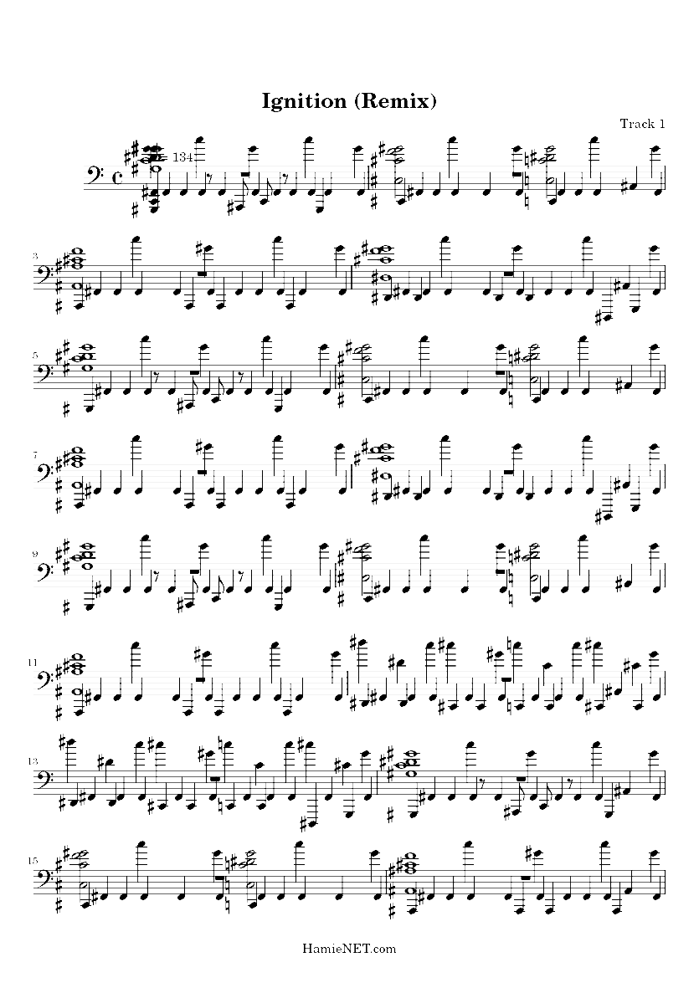

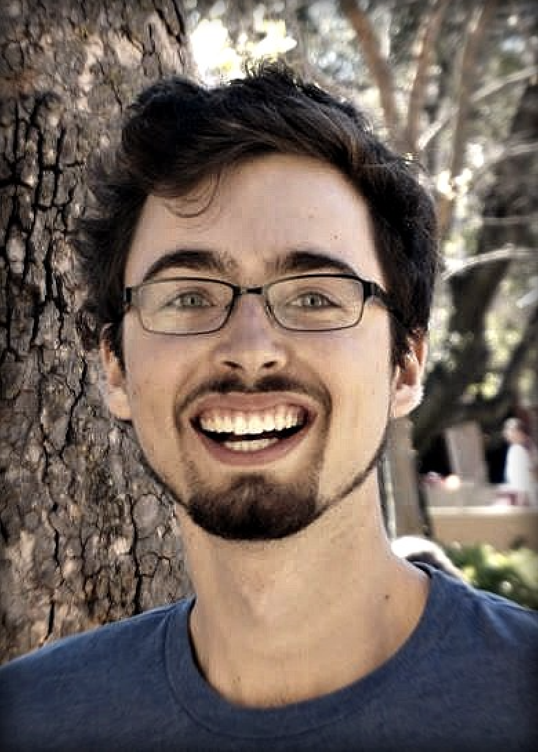
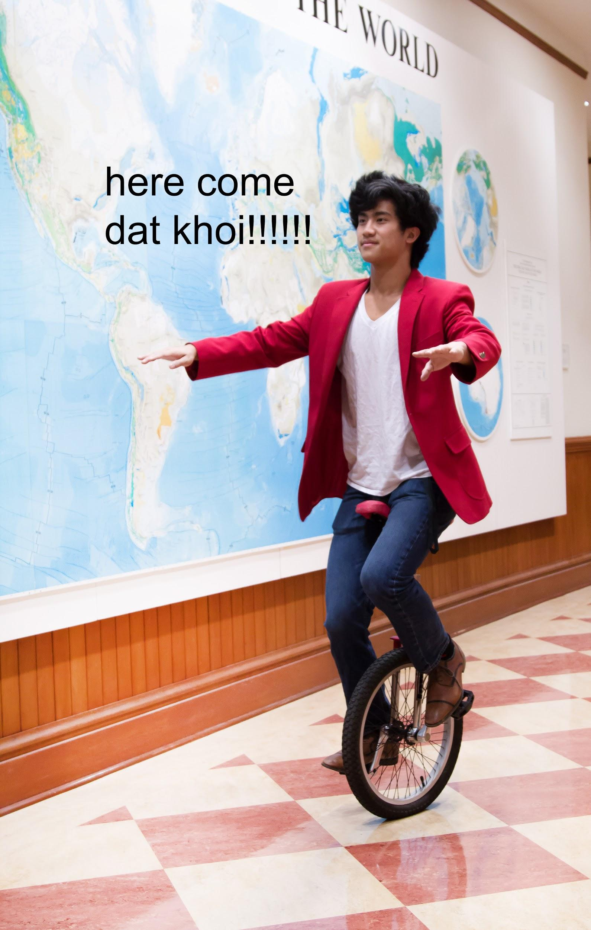
Stefan Swaans
B.S CS 2018
David Mora
B.S CS 2018
Khoi Le
B.S SymSys 2020

Slide 3
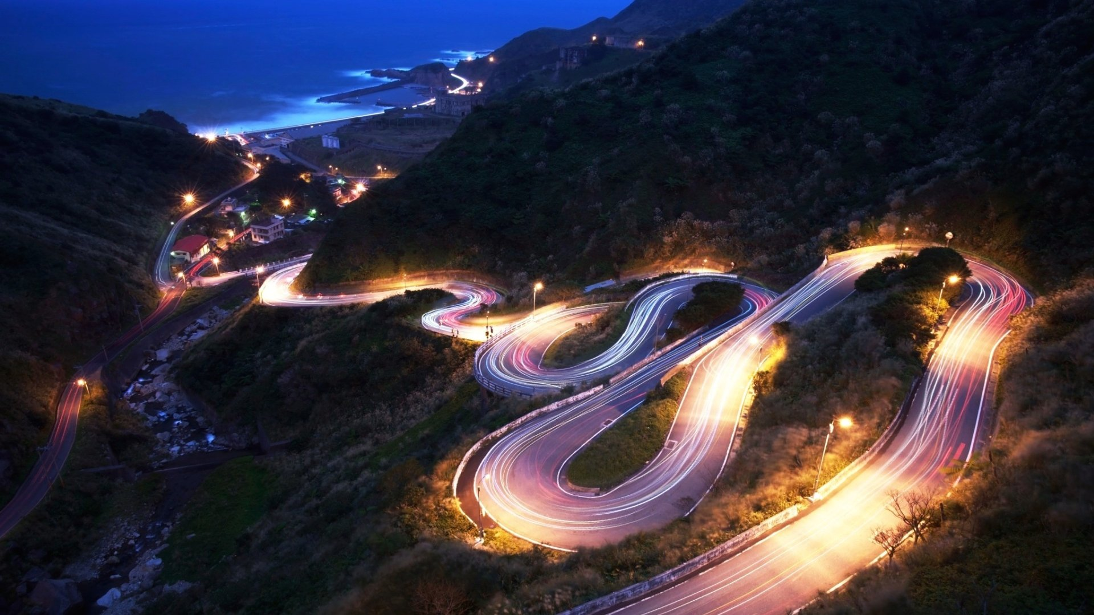
Initial POV

Slide 4
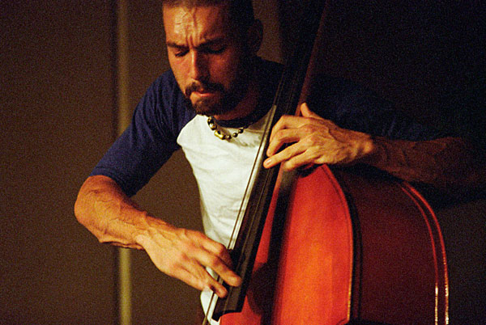
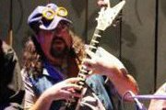
Josh is a jazz bassist and instructor
Ronna is a drum student
Paul is a guitar teacher

Slide 5

Results
Results
Some representation of practice grind vs practice high (ronna vs josh)
(paul fits in here too, bc sometimes playing the optimal music for your education is a grind, whereas playing the music you like can be a high)

Slide 6
Practice Grind → Practice High

Slide 7

Make Practice
A Reward
Notes:
Make practice a reward

Slide 8
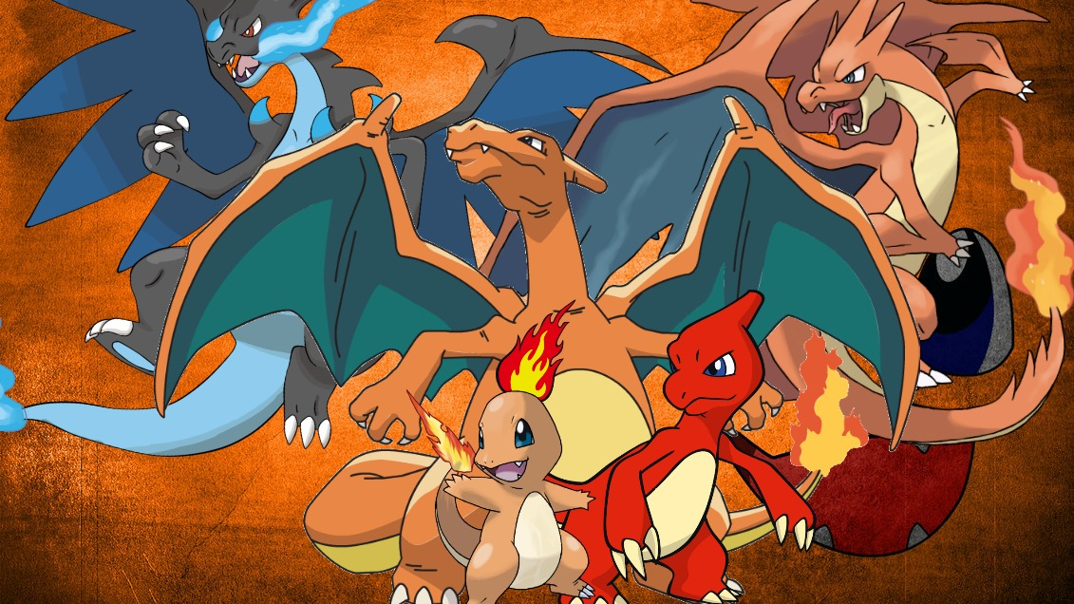
prototype1
Musical
Pokémon
Notes:
pokemon

Slide 9
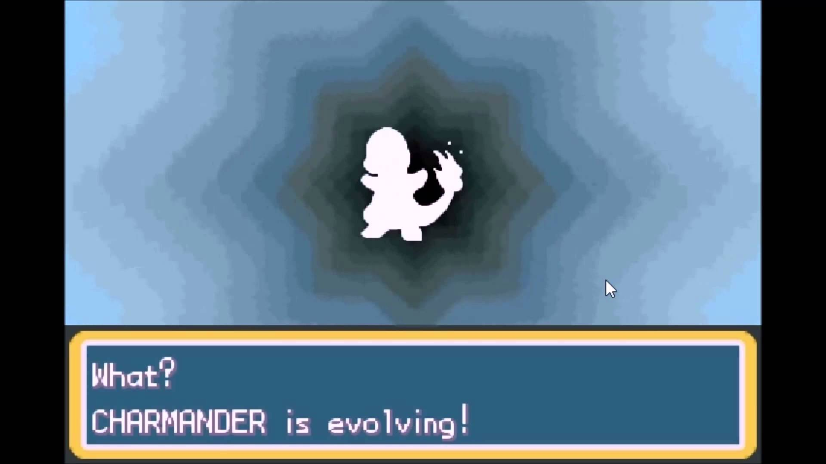
Musical Pokémon
Start with a simple piece of music
As progress is made → Evolve!
Intrinsic reward of mastering > pokemon excitement
Metaphor aided decomposition & progress tracking
Notes:
Short description of the prototype and how it was tested (with pictures for both) b. Results: 1-2 bullets on each of: Things that worked, things that didn’t work, surprises, and new learnings c. Validity: Was the assumption valid? Why or Why Not? Any new assumptions that emerged?

Slide 10
“I kind of understood it the whole time, but I wanted to master it. It did feel like I was leveling up, the new me could make all these new insights.”
Notes:
Short description of the prototype and how it was tested (with pictures for both) b. Results: 1-2 bullets on each of: Things that worked, things that didn’t work, surprises, and new learnings c. Validity: Was the assumption valid? Why or Why Not? Any new assumptions that emerged?

Slide 11
“I kind of understood it the whole time, but I wanted to master it. It did feel like I was leveling up, the new me could make all these new insights.”
Notes:
Short description of the prototype and how it was tested (with pictures for both) b. Results: 1-2 bullets on each of: Things that worked, things that didn’t work, surprises, and new learnings c. Validity: Was the assumption valid? Why or Why Not? Any new assumptions that emerged?

Slide 12
Importance of visualizing and understanding the
utility,
significance,
excitement
your practice goal promises...
Notes:
Short description of the prototype and how it was tested (with pictures for both) b. Results: 1-2 bullets on each of: Things that worked, things that didn’t work, surprises, and new learnings c. Validity: Was the assumption valid? Why or Why Not? Any new assumptions that emerged?

Slide 13
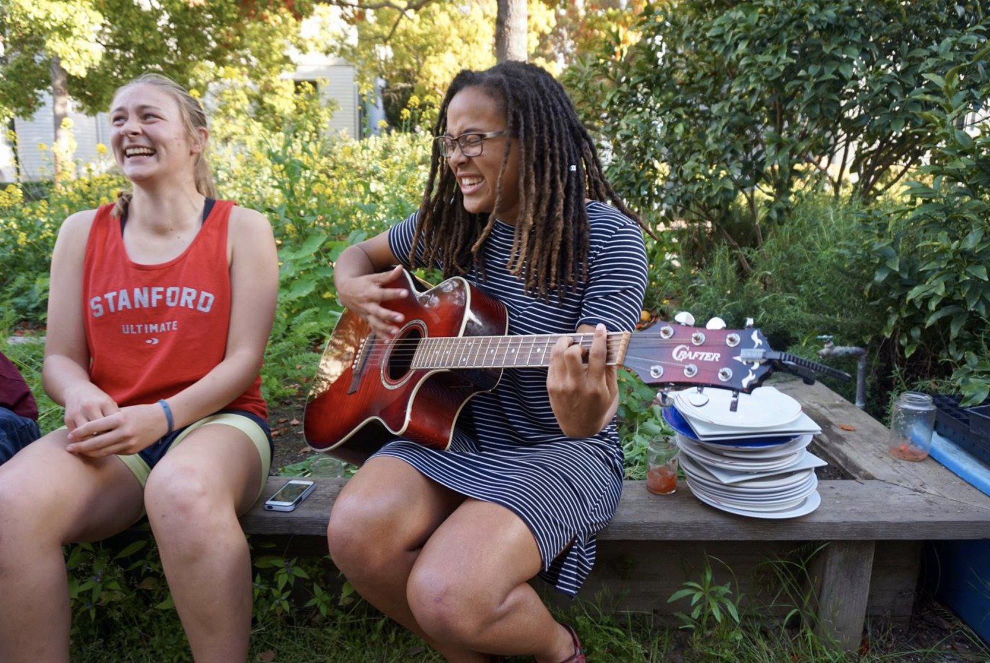

Slide 14
pov1
Self-doubt→
Self-confidence
Notes:
Self-doubt to self-confidence journey

Slide 15

hmw1
Capacity
For Improvement
Notes:
How might we capacity for improvement

Slide 16

prototype1
Inner Critic vs. Affirmer
Notes:
Inner critic vs affirmer

Slide 17
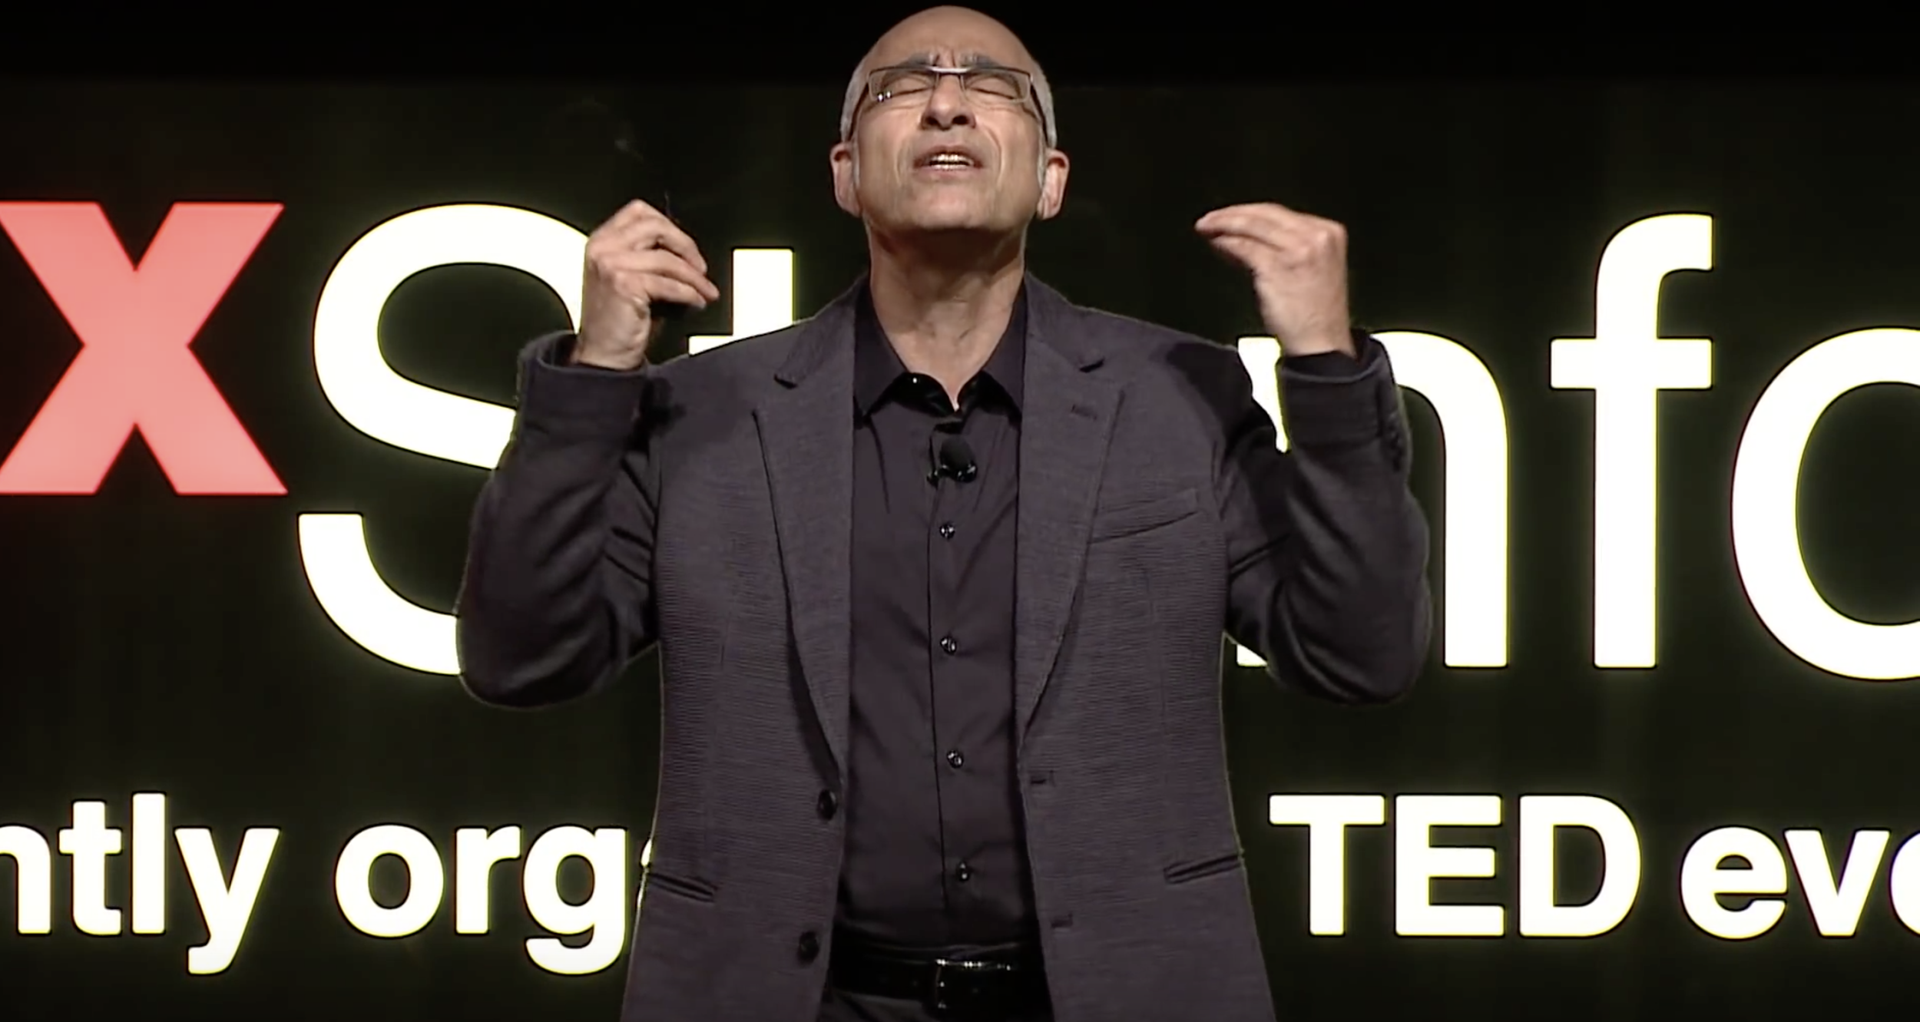
Shirzad Chamine

Slide 18
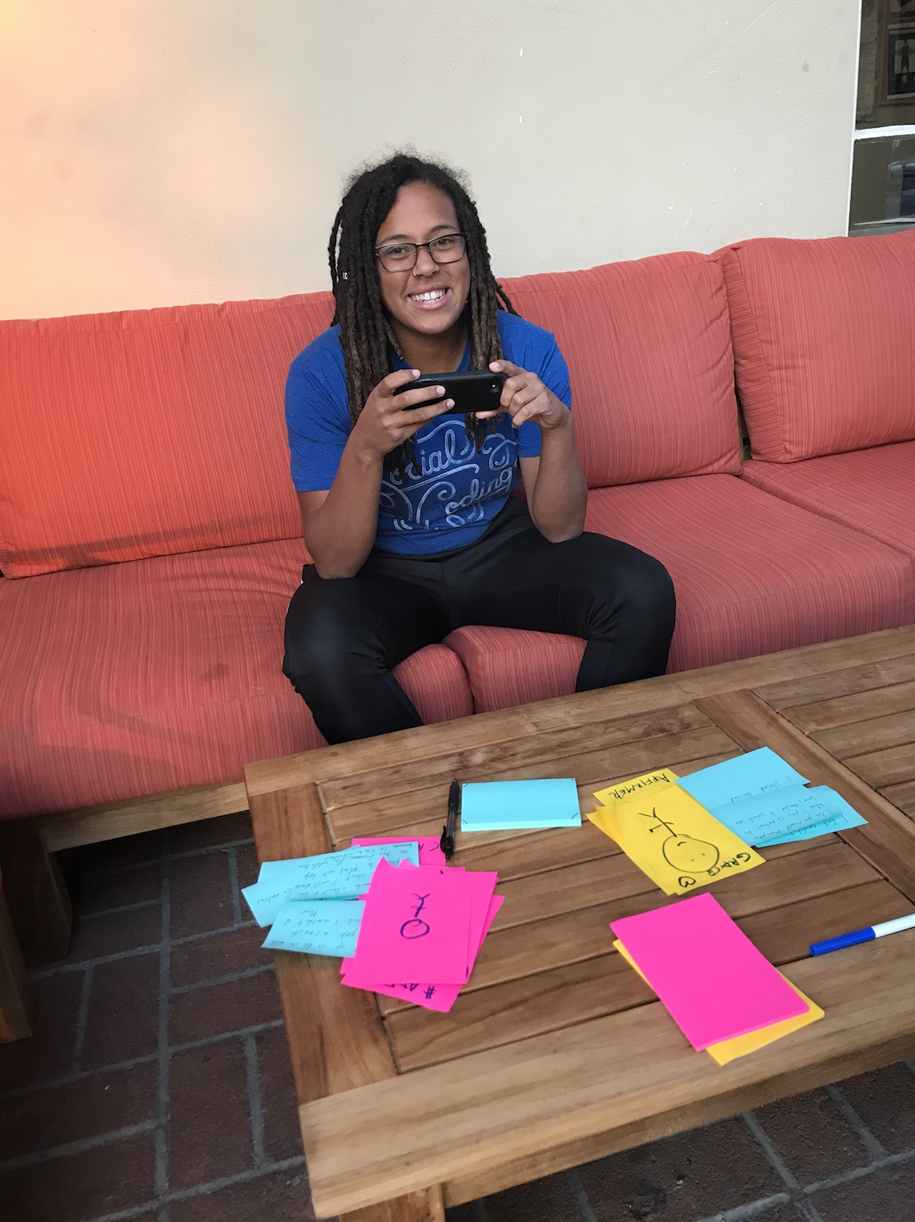
Inner Critic vs. Inner Affirmer
Post-practice reflection
Fill out post-its based on prompts (i.e “What did you do well?”)
Two stick figures, affirmer and critic, grow and shrink based on quality of self-reflection
Michelle increased in intentionality with how she framed thoughts
Tension: dichotomy vs blended “coach”
Notes:
Short description of the prototype and how it was tested (with pictures for both) b. Results: 1-2 bullets on each of: Things that worked, things that didn’t work, surprises, and new learnings c. Validity: Was the assumption valid? Why or Why Not? Any new assumptions that emerged?

Slide 20
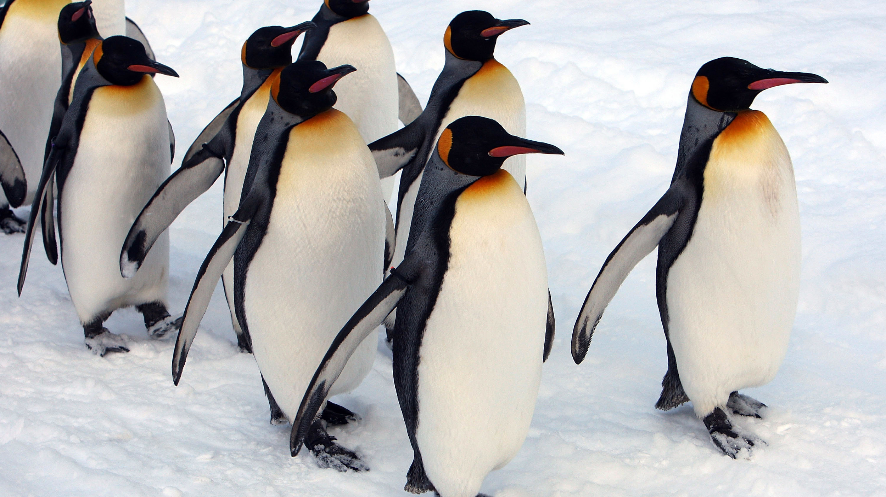
pov1
Camaraderie
Notes:
camaraderie

Slide 21
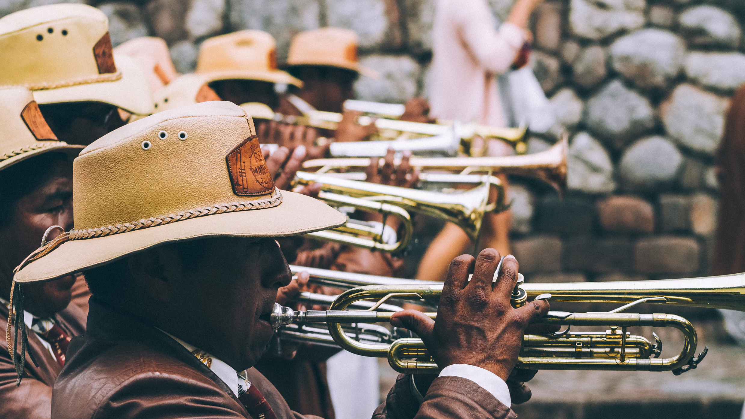
hmw1
Unite Similar Musicians
Notes:
Unite similar musicians

Slide 22
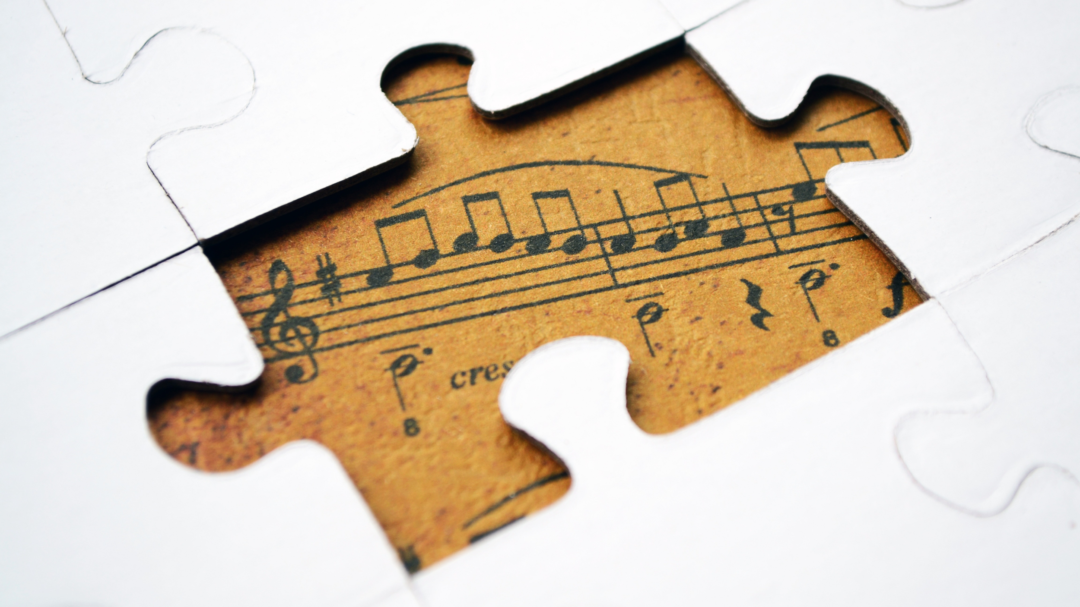
prototype1
Escape the Room
Notes:
Escape the room musical

Slide 23
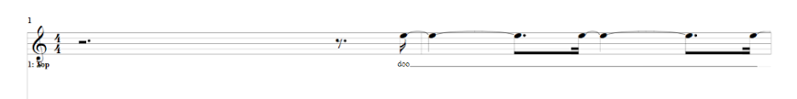
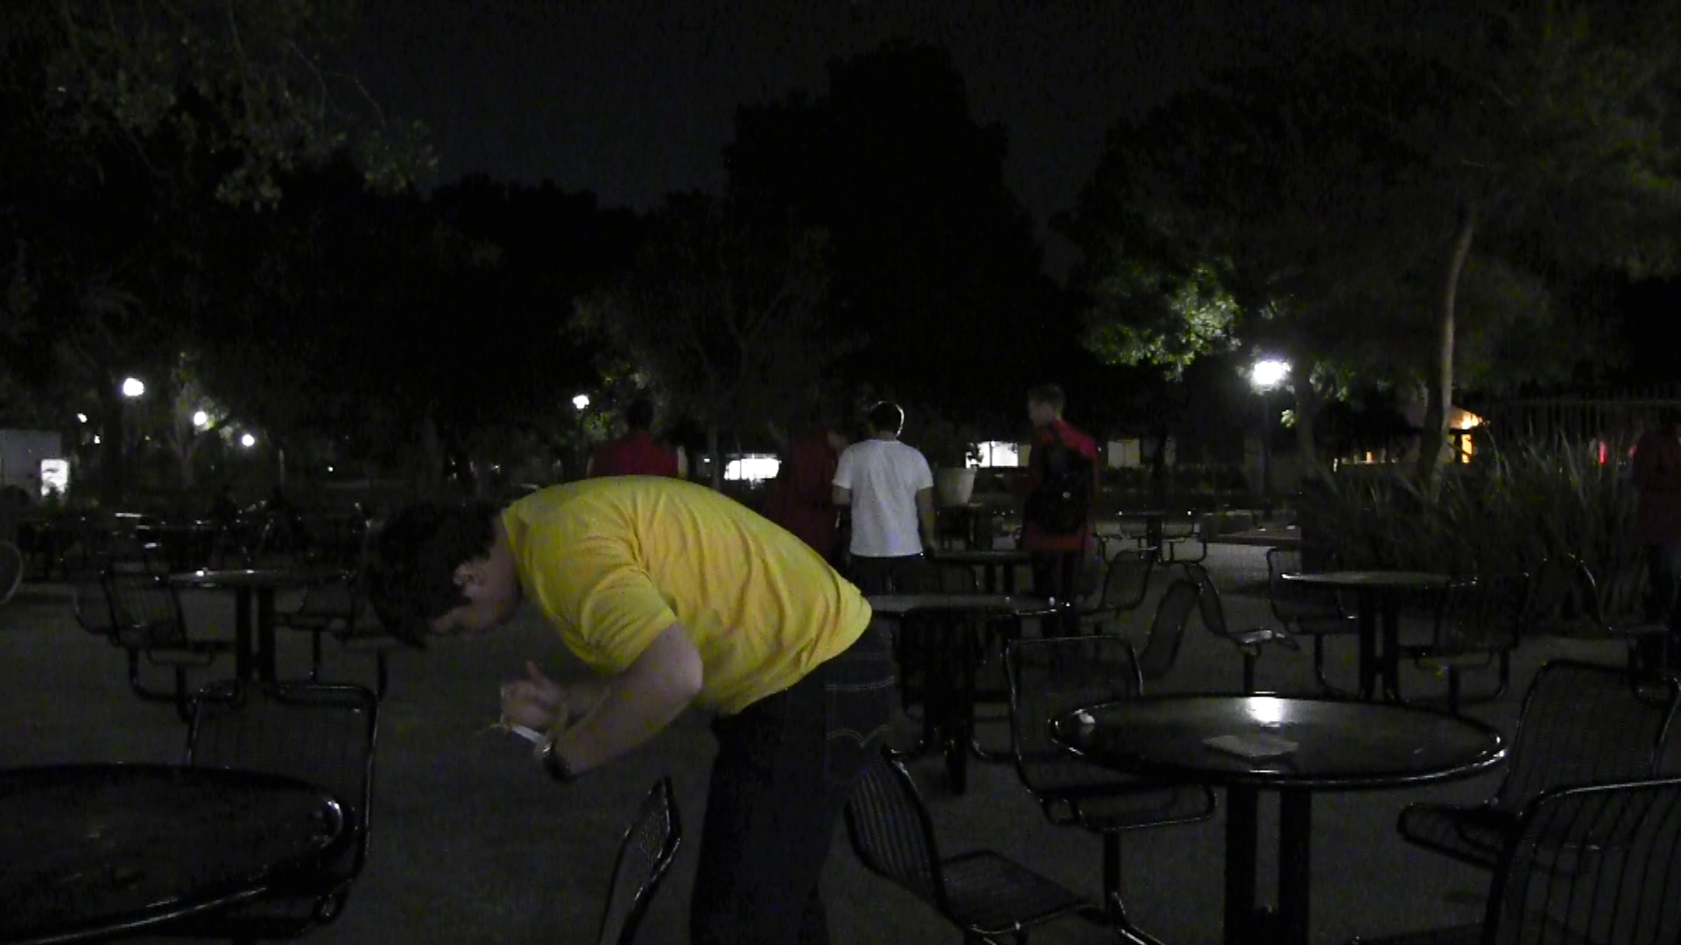
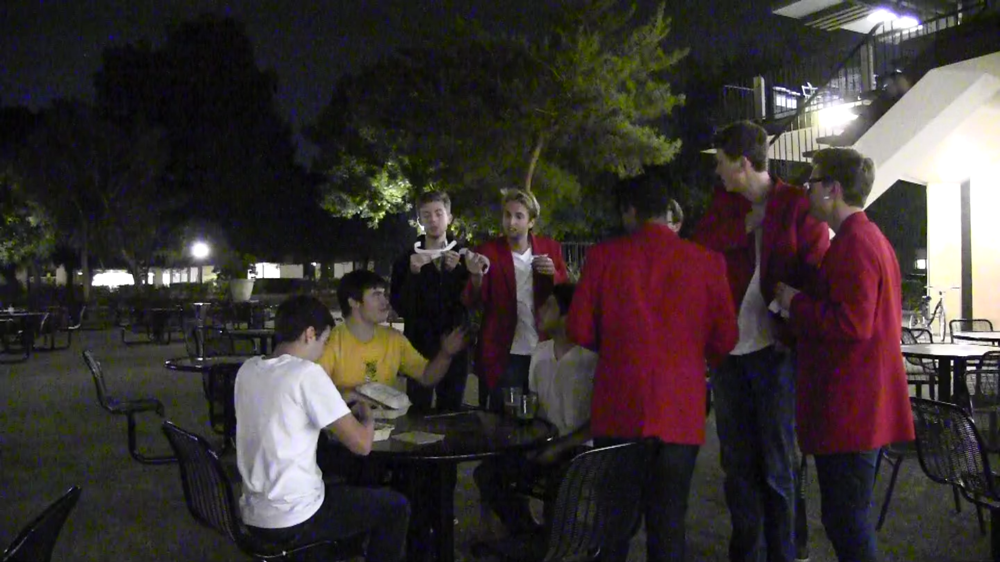
Escape the Room
Hidden slips of music form a puzzle
Teams learn their own part, then reconvene and sing together
Reluctance → Fun, engagement
Normal practice + urgency, exploration, incentive
Notes:
Short description of the prototype and how it was tested (with pictures for both) b. Results: 1-2 bullets on each of: Things that worked, things that didn’t work, surprises, and new learnings c. Validity: Was the assumption valid? Why or Why Not? Any new assumptions that emerged?
Yellow shirt photo, robby found a piece of music while others search in the back
Crowded photo, mendicants reconvene and sing together

Slide 24
?

